Slide 1
Latent Dirichlet Allocation
Avinita Shetty
Vishwa Shah
Jun Wu

Slide 2
Table of content
What is topic models
What is LDA
Understand LDA
How LDA works
Who’s using LDA
Pros & Cons
Implementation
Python
R
Evaluation
Q&A

Slide 3
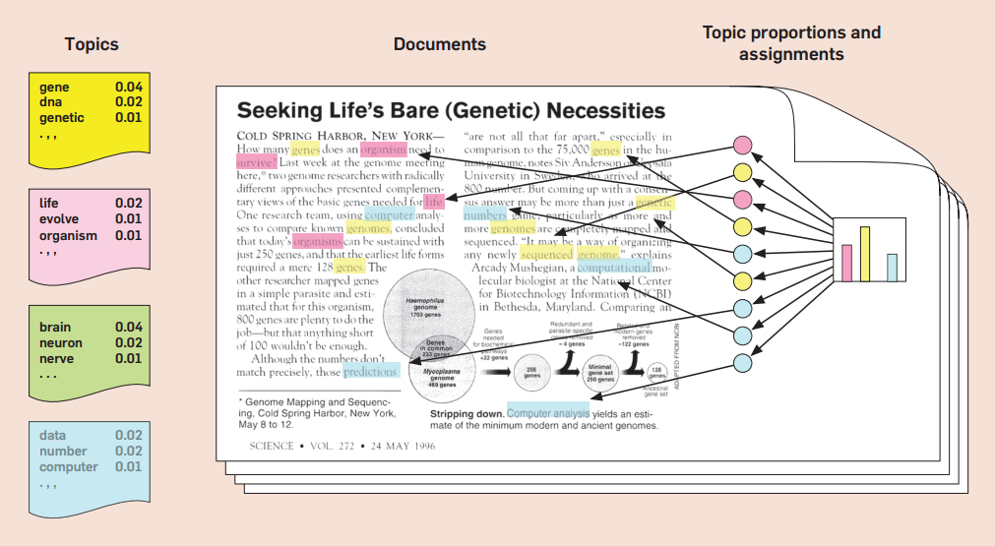
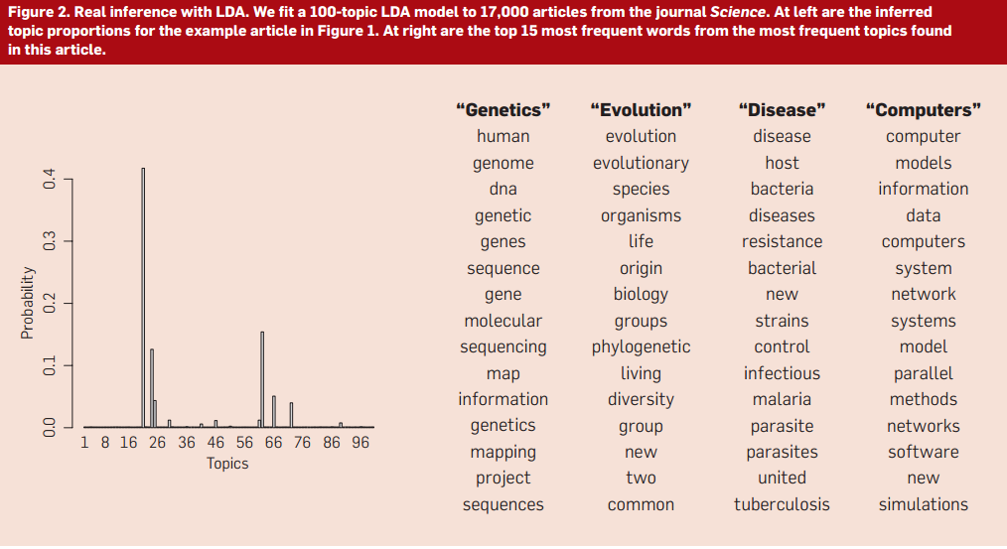
What is Topic models
“A form of text mining in order to identifying patterns in a corpus.”
“A method for finding and tracing topics (clusters of words) in large bodies of texts”
Topic models are algorithms for discovering the main themes that pervade a large and unstructured collection of documents. Topic models can organize the collection according to the discovered themes.
Primary usage - NLP
Notes:
Topic models are algorithms for discovering the main themes that creates a large and unstructured collection of documents.
By applying topic models into a collection of documents, the hidden value beneath every word can be discovered.
Science magazine uses topic model (LDA) to extract 100 topics among 17,000 papers.

Slide 4
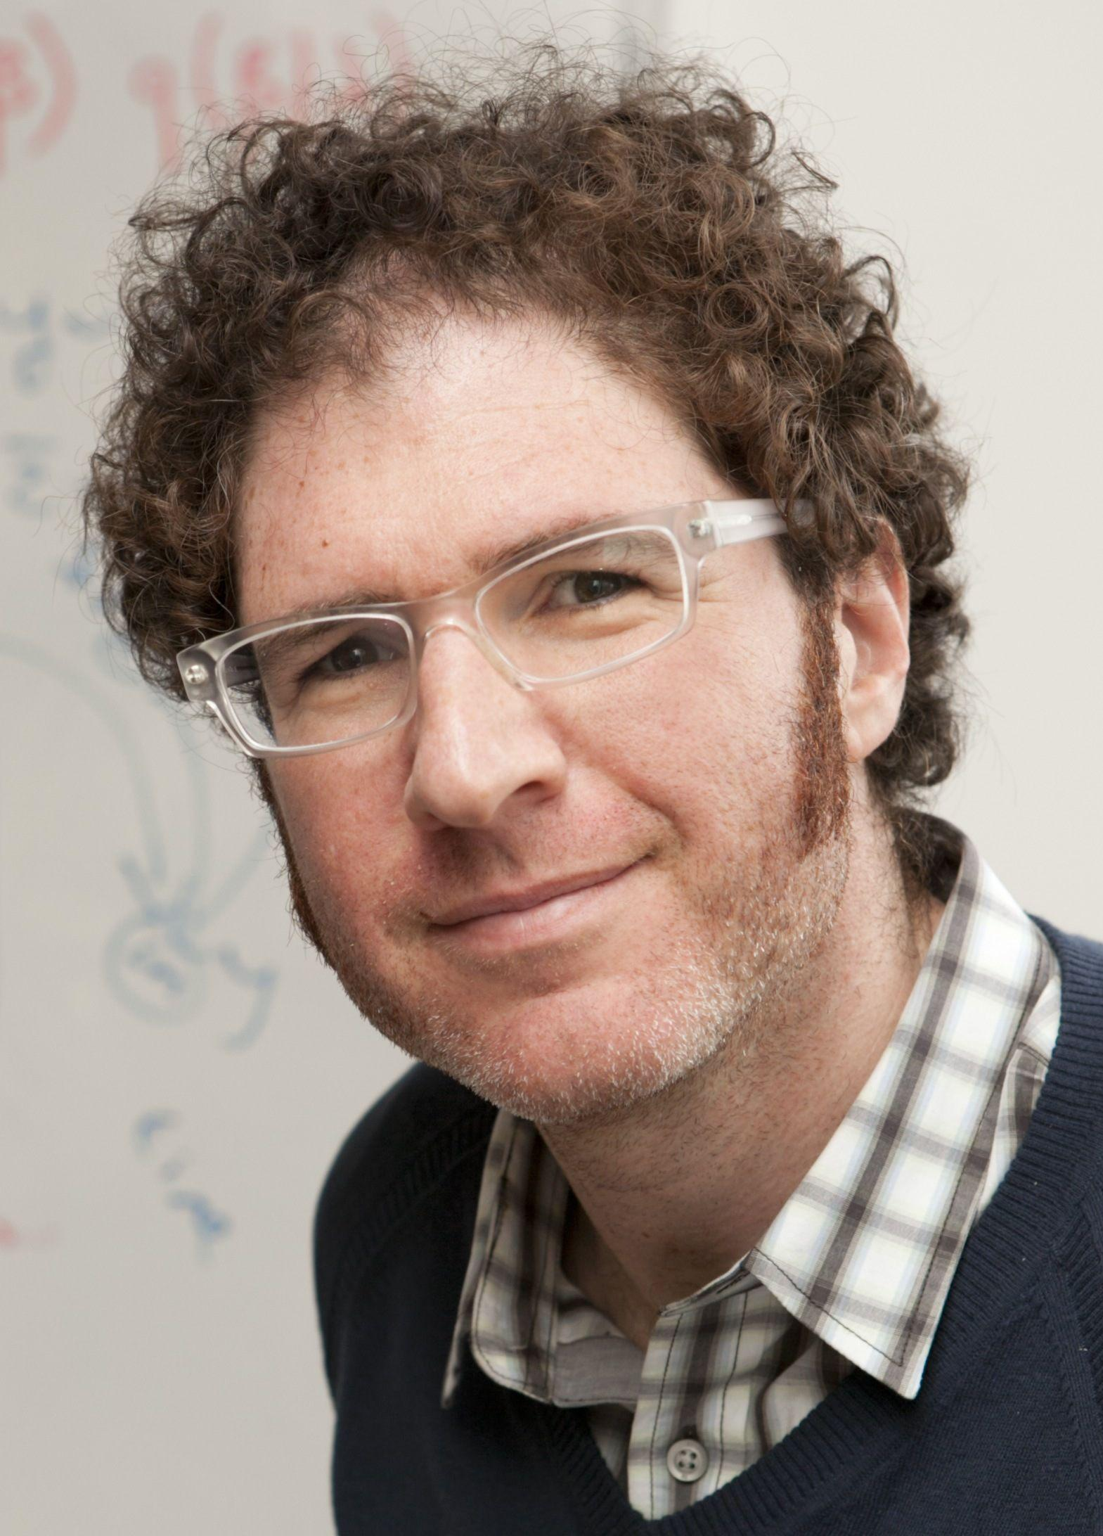
LDA - Latent Dirichlet Allocation
A three-level hierarchical Bayesian model
A generative probabilistic model for collections of discrete data such as text corpora
An unsupervised data mining algorithm mainly used for clustering purpose
Application:
Used in Automatic Categorization of Software
Bug Localization
Face Recognition
Video Fingerprinting
Used in various search engines
“Simplest topic model”
Notes:
LDA is a three-level hierarchical Bayesian model,
in which each document of a collection is modeled as a finite mixture over an set of topics
.
Each topic is, modeled as an infinite mixture over an set of topic probabilities.
In the context of text modeling, the topic probabilities provide an explicit representation of a document.

Slide 5
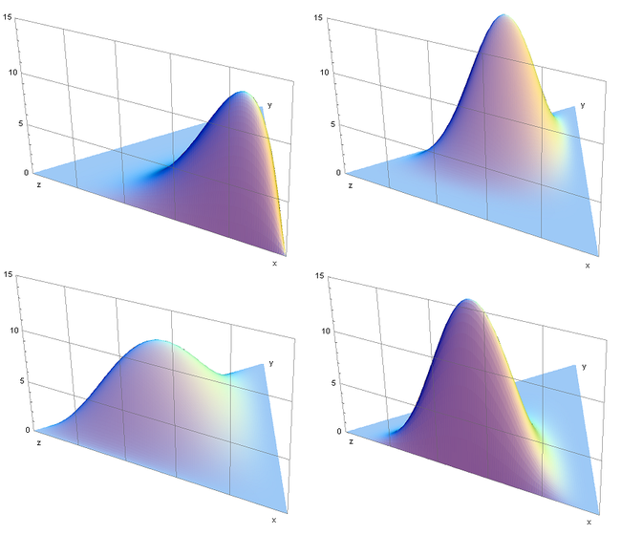


Understand LDA
Latent topics
Hypothesis: Bag of words
(De Finetti Theorem)
Dirichlet Distribution
where
Notes:
In probability and statistics, the Dirichlet distribution is a family of continuous multivariate probability distributions
A specific distribution is decided by a vector alfa.
0.3 - 2
α=(6, 2, 2), (3, 7, 5), (6, 2, 6), (2, 3, 4).
Dirichlet distribution is the conjugate prior of the categorical distribution and multinomial distribution
Theorem (De Finetti)–words in a document are infinitely exchangeable, then the joint probability of a specific topic has a representation as a mixture of words.

Slide 6
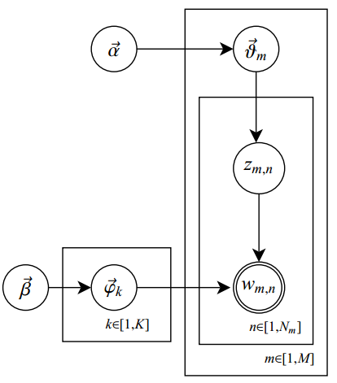






Understand LDA
Generative model
5-steps to generate a word.
M: Number of documents.
N: Number of words.
K: Number of topics
Hyperparameters to generate probability distribution
Topic
Word
Topic distribution of a document
Word distribution of a topic

Slide 7
How LDA works
Pre-processing
Inference & Estimation
EM v.s. Gibbs Sampling
EM: the joint probability of all latent variables
Gibbs Sampling: the individual conditional probability of each latent variable
Experimental Results
List of topics with their own group of words
List of documents with each word’s topic.
Notes:
EM
Gibbs sampling

Slide 8
Who are using LDA?
The most common Topic Model currently in use is LDA.
A Research Director at Google, Edward Y. Chang, is currently working on an implementation of LDA which utilizes a parallel computing architecture, allowing it to take advantage of the massive computing power Google has at its disposal
Used in building New York Times Recommendation Engine
By adding classified into six classes, including skin color of normal, cyan, red, yellow, black, and white and turn LDA into Supervised LDA, it helps to provides useful descriptive statistics for facial diagnosis in Traditional Chinese Medicine.
Notes:
Biomedical Engineering and Informatics

Slide 9
Pros & Cons
Pros:
LDA compared to LSI is a probabilistic model with interpretable topics that can be easily extended and embedded in other more complicated models
LDA is generalizable to unseen documents. The other(pLSA) assume the distribution of topics/words are following the same pattern in all documents.
Cons:
One of the drawback of LDA is that the algorithm fails to draw the relationship from one topic to another
The technique uses several tuning parameters whose impact on the resulting LDA model are not always intuitive. Values for the tuning parameters is dependent on both the problem that is being addressed and the input corpus

Slide 10
Implementation
Python
R

Slide 11
Evaluation
Evaluation for unsupervised algorithms like LDA is difficult.
HUMAN-IN-THE-LOOP
Word Intrusion: For each trained topic, take first ten words, substitute one of them with another randomly chosen word(intruder) and see whether a human can reliably tell which one of word is the intruder. If so then the topic is Coherent(good), if not the topic has no discernible theme(bad).
Topic Intrusion: Subjects are shown a title and snippet from a document. Along with document they are presented with four topics. Three of them are high probability topics assigned to that document. The remaining intruder topic is chosen from other low probability topics in the model. They need to determine which is the low probability topic.
The Mechanical Turk can be used for this purpose.

Slide 12
Q&A

